Slide 1


TRAFFIC CLEARANCE SYSTEM FOR AN AMBULANCE
CMR COLLEGE OF ENGINEERING & TECHNOLOGY
(Autonomous)
Kandlakoya, Medchal, HYDERABAD
CENTRE FOR ENGINEERING EDUCATION RESEARCH
REVIEW-II
SOCIAL INNOVATION IN PRACTICE (A400507)
III SEMESTER A.Y 2023-24
Student Team Details
G. Sachurya - 21H51A6209
K. Shivanand - 22H51A6226
M. Abhign Reddy- 22H51A6235
V. Pranav - 22H51A6259
A. Sai Nikhila - 22H51A6205
A. Ajay – 22H51A6203
Faculty Mentors
Mr. B. Suresh Ram
Mr. K. Ravi Kiran
Mr. K. Sathish
Traffic Clearance System For An Ambulance CMR College of Engineering & Technology

Slide 2

CONTENT
Problem Statement
Existing Solutions
Gaps in Existing Solutions
Proposed Solution
Components required
Block Diagram
Flow Chart
Working Principle of all components used
Working of the model
Results and Conclusions
Advantages and Disadvantages
Conclusion
References
Traffic Clearance System For An Ambulance CMR College of Engineering & Technology

Slide 3

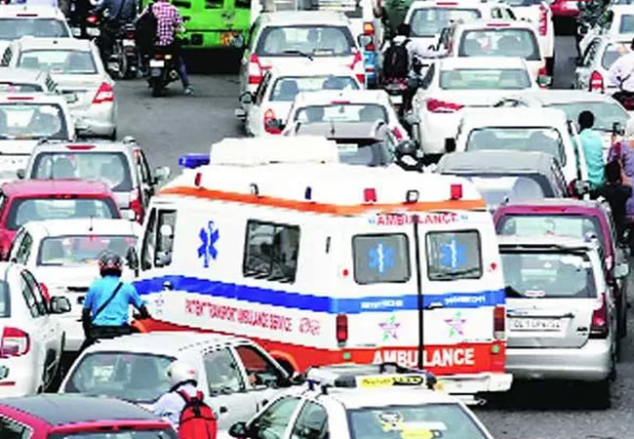
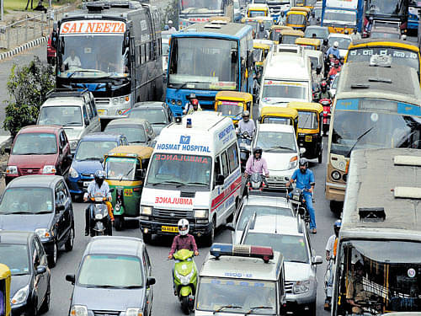
PROBLEM STATEMENT
Traffic problems were recognized as major problem in big cities, which have caused many difficulties for the ambulance. Moreover, road accidents in the city have been increase and to bar the loss of life due to the accidents is even more crucial.
The main reason behind this idea is to provide a clear path for the ambulance to reach the hospitals in time and thus minimizing the deaths.
Traffic signal prioritize the ambulance and makes its path easier to cross heavy traffic.
Traffic Clearance System For An Ambulance CMR College of Engineering & Technology

Slide 4

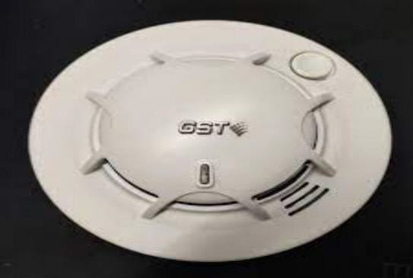
EXISTING SOLUTIONS
Google Assisted service:
ii. Manual Alarm/Buzzer:
Traffic Clearance System For An Ambulance CMR College of Engineering & Technology

Slide 5
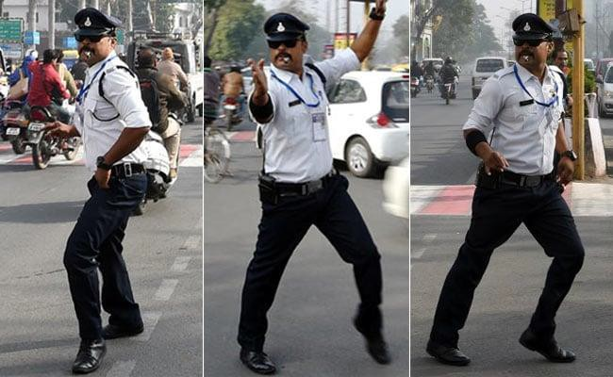

EXISTING SOLUTIONS
iii. Traffic Duty Officer:
iv. Traffic Signals:
Traffic Clearance System For An Ambulance CMR College of Engineering & Technology

Slide 6
GAPS IN EXISTING SOLUTIONS
Traffic police has to keep his efforts for clearing the way to ambulance.
As alarm sounds but it can’t reach more distance and the people in other lanes don’t know what’s going on and they move as regular condition.
Traffic Signals has some disadvantages:
Traffic Congestion: Signals can contribute to congestion, particularly during peak hours, as they regulate the flow of traffic and may not always optimize for efficiency.
Delays: Drivers may experience delays at traffic signals, leading to longer travel times and potential frustration.
Fuel Consumption and Emissions: Stop-and-go traffic at signals can result in increased fuel consumption and higher emissions, contributing to environmental concerns.
Traffic Clearance System For An Ambulance CMR College of Engineering & Technology

Slide 7
PROPOSED SOLUTION
In this project, the functionality revolves around the code we craft and the sensors we employ.
When an ambulance navigates through traffic, a RFID card affixed on its roof is scanned by a RFID reader.
Upon detection, the system triggers a signal to the traffic lights, prompting them to switch to green.
The code, responsible for interpreting sensor input, directs the console to display pertinent information regarding the sensed properties and input types.
The successful execution of this code and the accuracy of the sensors are pivotal for the seamless operation of the system.
Communicate
Iterate
Traffic Clearance System For An Ambulance CMR College of Engineering & Technology

Slide 8
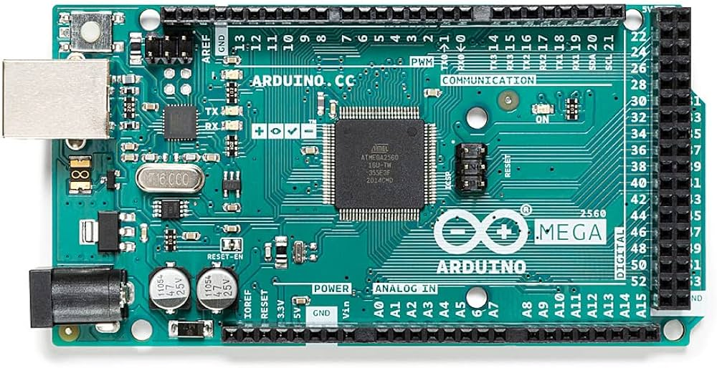
COMPONENTS REQUIRED
Arduino Mega:
The Arduino Mega 2560 is a microcontroller board based on the ATmega2560. It has 54 digital input/output pins 16 analog inputs, 4 UARTs a 16 MHz crystal oscillator, a USB connection, a power jack, an ICSP header, and a reset button. It contains everything needed to support the microcontroller; simply connect it to a computer with a USB cable or power it with a AC-to-DC adapter or battery to get started. The Mega 2560 board is compatible with most shields designed for the Uno and the former boards Duemilanove or Diecimila.
Traffic Clearance System For An Ambulance CMR College of Engineering & Technology

Slide 9
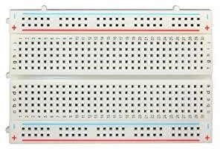
COMPONENTS REQUIRED
2. Breadboard:
The Connections are given on this board for proper flow of the circuit.
3.Jumper Wires:
With these wires, the connections are given, This makes the connection of modules to the Arduino, so that correct functioning of the project or modules takes place. The whole project is connected using jumper wires.
Traffic Clearance System For An Ambulance CMR College of Engineering & Technology

Slide 10
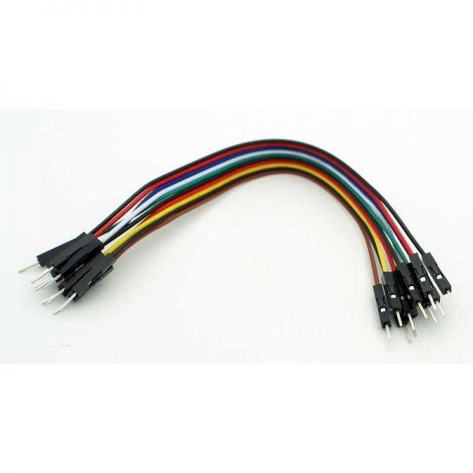
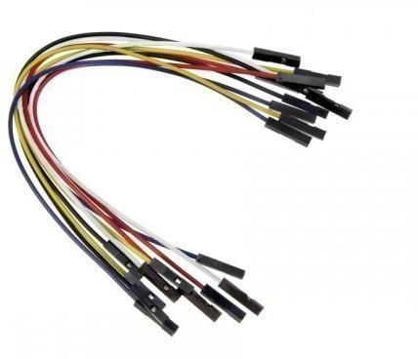
COMPONENTS REQUIRED
i. Male-to-Male jumper wires:
ii. Female-to-Female jumper wires:
Traffic Clearance System For An Ambulance CMR College of Engineering & Technology

Slide 11
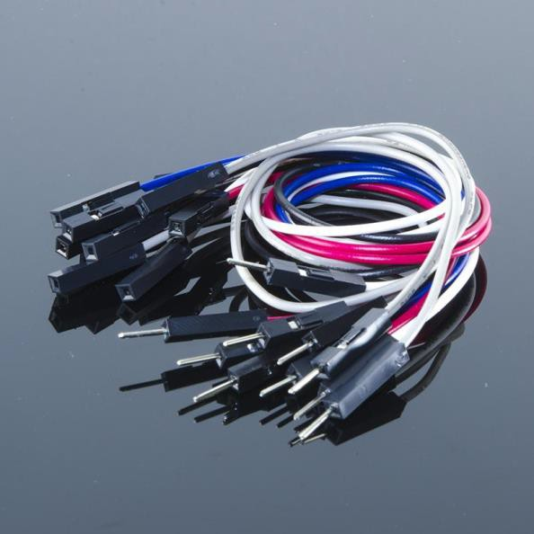
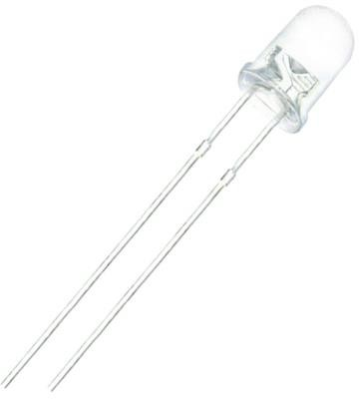
COMPONENTS REQUIRED
iii. Male-to-Female jumper Wires:
4. LED’S(3 colours):
Traffic Clearance System For An Ambulance CMR College of Engineering & Technology

Slide 12
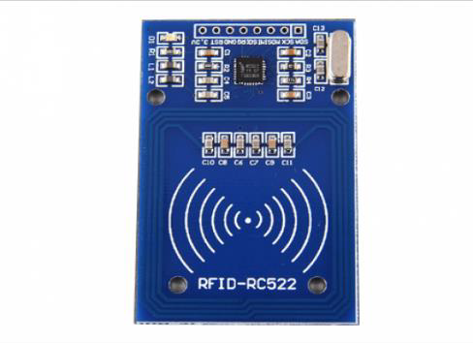
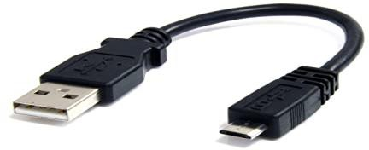

COMPONENTS REQUIRED
5. RFID Reader:
6. USB cable:
7. RFID Cards:
Traffic Clearance System For An Ambulance CMR College of Engineering & Technology

Slide 13
BLOCK DIAGRAM
1) Input components – RFID Reader, RFID Tag
2) Controller-Arduino Mega
3) Output components- Traffic Signals
INPUT
(RFID Reader
RFID Tag)
ARDUINO MEGA
OUTPUT
(Traffic Signals)
Traffic Clearance System For An Ambulance CMR College of Engineering & Technology

Slide 14
WORKING OF THE MODEL
(STEP WISE EXECUTION)
Step-wise execution flow for the described project where an ambulance navigating through traffic triggers traffic lights to switch to green using RFID technology:
RFID Card Affixed on Ambulance Roof:
Affix an RFID card securely on the roof of the ambulance.
RFID Reader Setup:
Install RFID readers at strategic points along the road where traffic lights are located.
RFID Card Detection:
As the ambulance moves through the road, the RFID reader detects the RFID card on its roof.
Sensor Input Interpretation Code:
Develop code to interpret the sensor input from the RFID reader.
Console Display Configuration:
Write code to direct the console to display pertinent information regarding the sensed properties and input types.
This information might include details about the ambulance, timestamp, and any relevant data from the RFID card.
Traffic Clearance System For An Ambulance CMR College of Engineering & Technology

Slide 15
WORKING OF THE MODEL (STEP WISE EXECUTION)
Traffic Light Control Code:
Develop a control code responsible for triggering the traffic lights to switch to green upon detection of the ambulance's RFID card.
This code interfaces with the traffic light control system.
Integration of RFID and Traffic Light Code:
Integrate the RFID sensor interpretation code and the traffic light control code.
Ensure seamless communication between these components.
Testing:
Conduct extensive testing to ensure the RFID card detection is accurate.
Verify that the traffic lights respond correctly to the RFID signal from the ambulance.
Error Handling and Logging:
Implement error-handling mechanisms in the code to address any unforeseen issues.
Set up logging to record events and potential errors for later analysis.
Traffic Clearance System For An Ambulance CMR College of Engineering & Technology

Slide 16
FLOW CHART
START
RFID card Affixed on Ambulance Roof
RFID Reader Setup
RFID Card Detection
Is RFID card detected
Yes
No
Sensor input interpretation code
End Ambulance Movement
Trigger Traffic light to Switch to Green
End Ambulance Priority
Traffic Clearance System For An Ambulance CMR College of Engineering & Technology

Slide 17
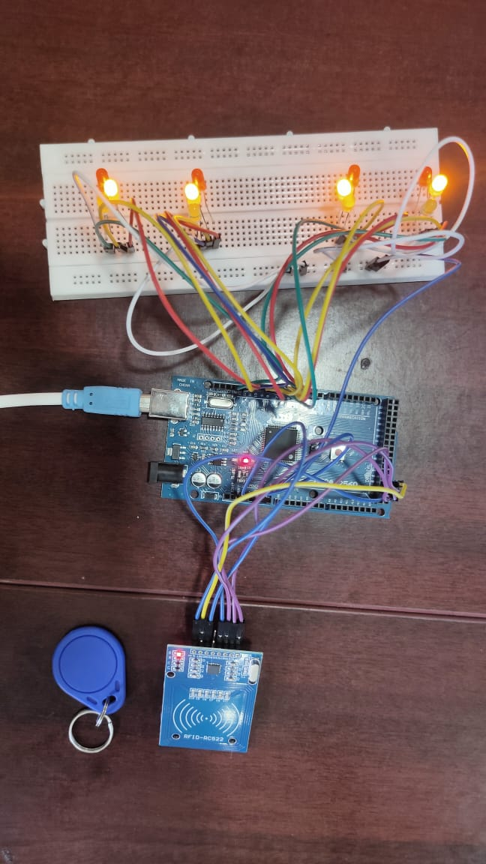
PROTOTYPE MODEL
Picture of the Project Model
Traffic Clearance System For An Ambulance CMR College of Engineering & Technology

Slide 18
RESULTS AND DISCUSSIONS
When the issue was identified, the immediate solution was for ambulances to move swiftly through traffic.
Traffic Clearance System For An Ambulance CMR College of Engineering & Technology

Slide 19
ADVANTAGES & DISADVANTAGES
ADVANTAGES
Saves lives by reducing the time required to transport patients to the hospital. Minimizes traffic disruptions and eases the burden on traffic police
DISADVANTAGES
The project heavily relies on technology, and any technical issues such as sensor malfunctions or code errors could compromise its effectiveness.
There is a possibility for Ambulance Driver’s to MISUSE this technology
Implementing RFID readers, sensors, and the associated infrastructure can be expensive, potentially posing financial challenges for widespread adoption.
Traffic Clearance System For An Ambulance CMR College of Engineering & Technology

Slide 20
CONCLUSION
By completing this project, we conclude by saying that our project is most useful to everyone in the society. And save their lives in a frequent manner. Hopefully, our project might stand as a diligent drop of advancement in this ocean of digitalization and social innovation and help the people to know the life of a human by “Traffic clearance system for an Ambulance”.
Traffic Clearance System For An Ambulance CMR College of Engineering & Technology

Slide 21
REFERENCES
https://ieeeaccess.ieee.org/featured-articles/securityintelligent_reflectingsurfaces/
https://ieeeaccess.ieee.org/tag/intelligent-transportation-systems/
https://ieeeaccess.ieee.org/closed-special-sections/artificial-intelligence-ai-empowered-intelligent-transportation-systems/
https://ieeeaccess.ieee.org/tag/smart-technologies/
Traffic Clearance System For An Ambulance CMR College of Engineering & Technology

Slide 22
WHAT WE DONE FROM REVIEW 2- 3
WE HAVE TRIED TO WORK WITH FOUR ARDUINO’S NEAR JUNCTIONS
WE TRIED TO ATTACH RFID CARD

Slide 23


